Slide 1
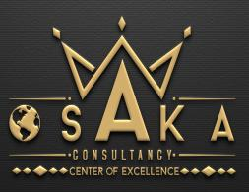
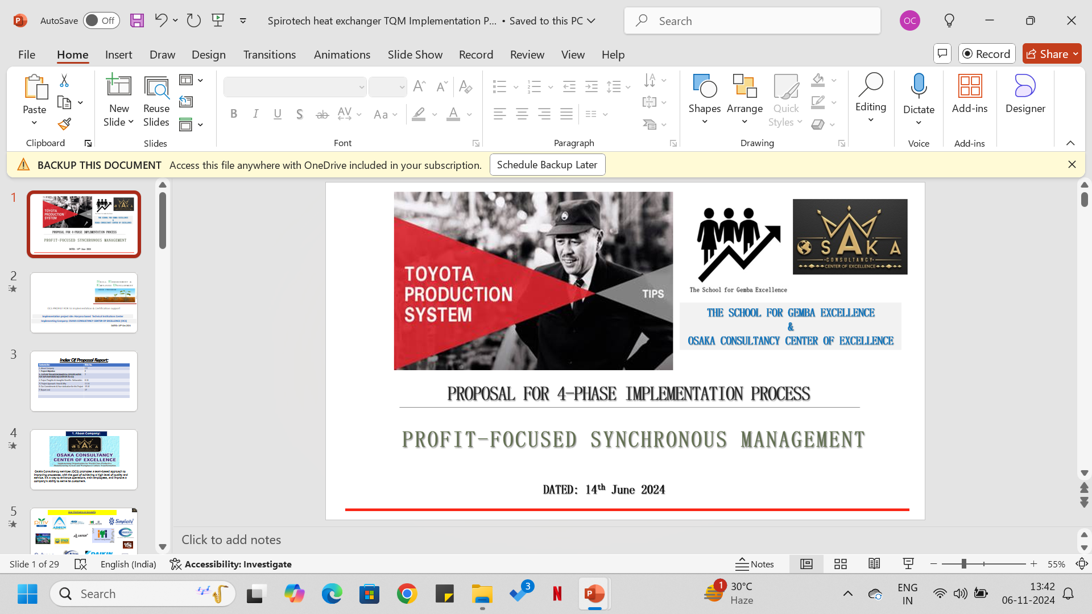
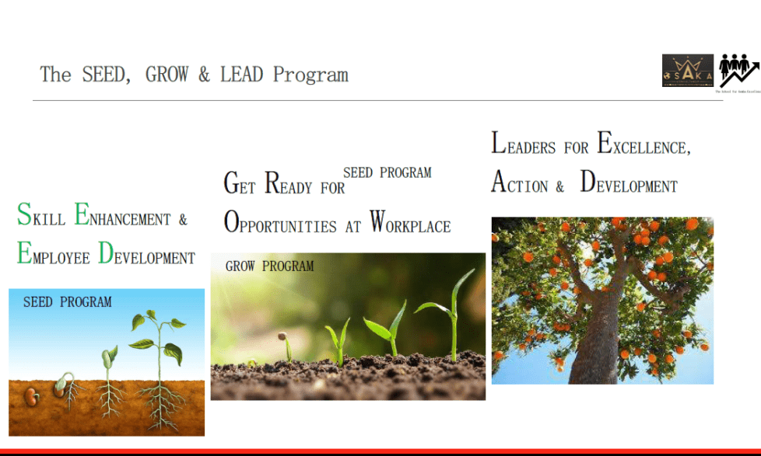
OCS PROFILE FOR TOTAL MANUFACTURING GLOBAL STANDARD IMPLEMENTATION & CERTIFICATION SUPPORT
Implementing Company: OSAKA CONSULTANCY CENTER OF EXCELLENCE (OCS)
DATED: 06th Nov.2024

Slide 2
Index Of Proposal Report:
Contents list: | Slide No.
1. About Company | 3-15
2. Project Objective & Techniques Introduction | 16-26
3. CULTURE TRANSFORORMATION-OPPORTUNITIES FOR IMPLEMENTATION(CONTENTS TO DO) | 27
4. Project Tangible & Intangible Benefits- Deliverables | 28-30
5. HOW – TQM STANDARDIZED FUNDAMENTAL TOOLS & TECHNIQUES | 31
6. Communication Mechanism during Implementation | 32
7. 5. Project Approach- How & Why | 33
8. Our Commitments & Your dedication for this Project | 34-35

Slide 3
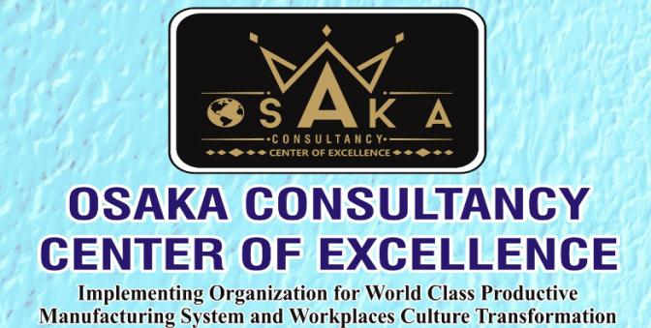
About Company:
Osaka Consultancy services (OCS) promotes a team-based approach to improving processes, with the goal of achieving a high level of quality and service. It’s a way to enhance operations, train employees, and improve a company’s ability to serve its customers.

Slide 4


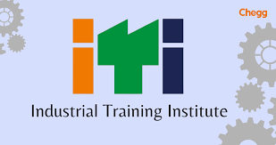







Our Partners in Growth:

Slide 5





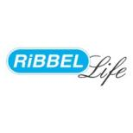


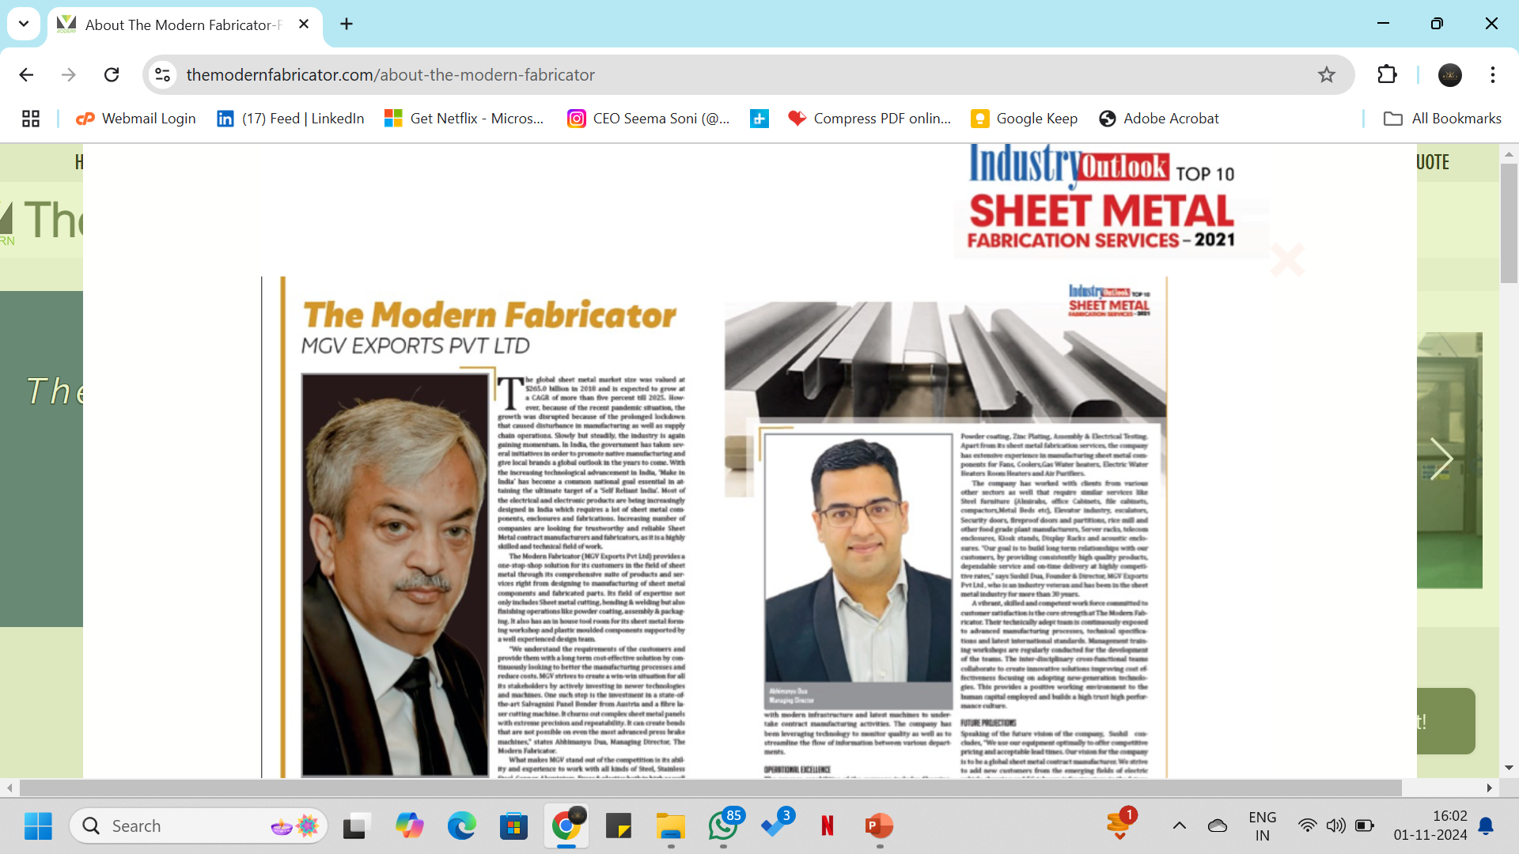
Our Partners in Growth:
MGV Exports Pvt. Ltd

Slide 6






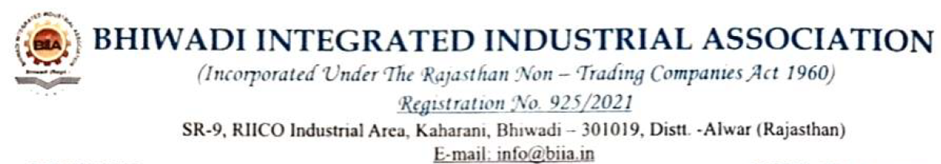

Associated with Professionals:

Slide 7
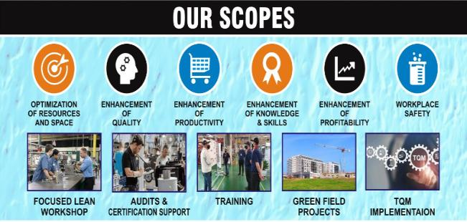
Auto/Non- Auto Segments of Industries Served :
Forgings & Machining Units
Green Field Industry Projects
Automobile Manufacturing Industry
Apparel Manufacturing Industry
Educational Technical Institution
Plastic Moldings Industry
Electronics Industry
Lighting Industry
Food & Beverages Mfg. Industry
Pharmaceutical Industry
Foot-Wear manufacturing Industry
Casting Foundry Units

Slide 8



Slide 9
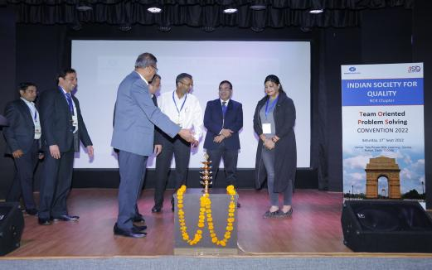
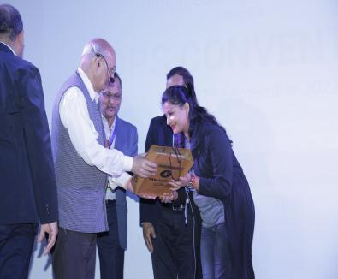
Award of honor from Ishikawa awarded , Deming distinguish service awarded , Lancaster Medal awarded TQM “TOTAL QUALITY MANAGEMENT” Guru Shree Janak Kumar Mehta who is business leader with focus on organizational transformation through quality management and business excellence across all functions and all levels based on holistic approach to management

Slide 10
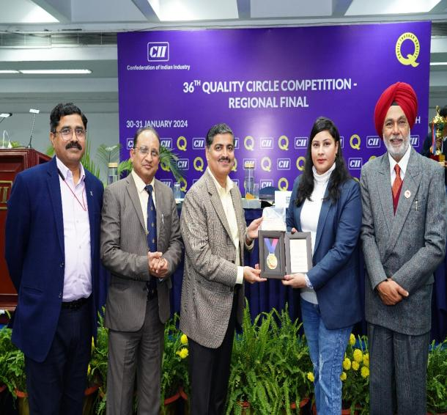
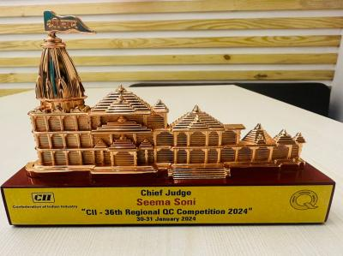
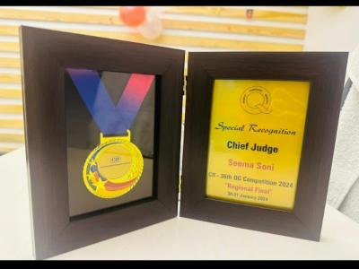

Slide 11
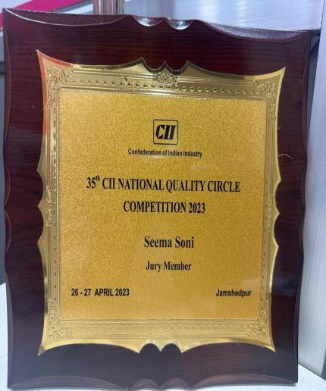
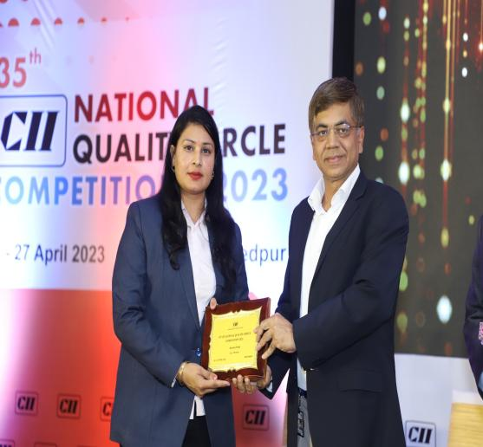

Slide 12
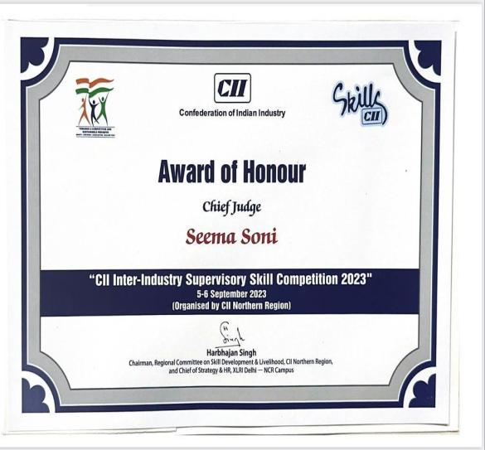
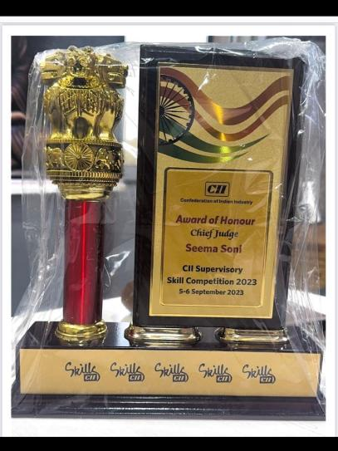

Slide 13
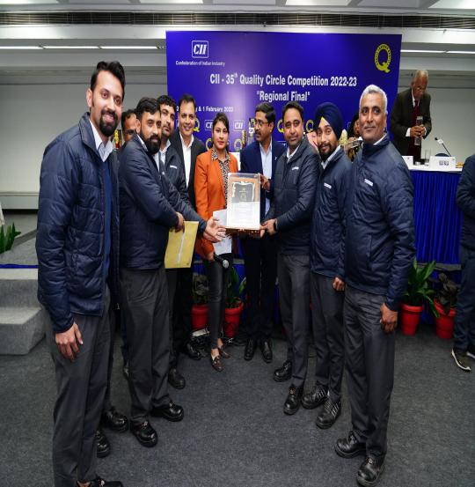
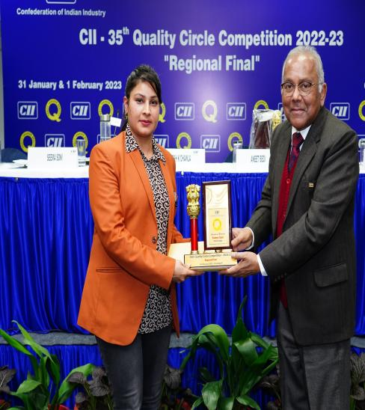

Slide 14
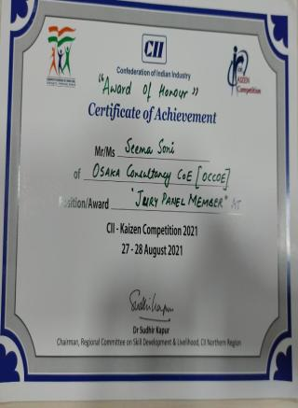
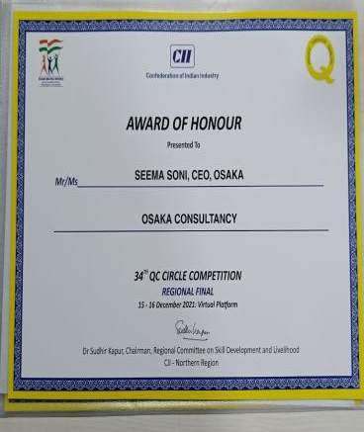

Slide 15
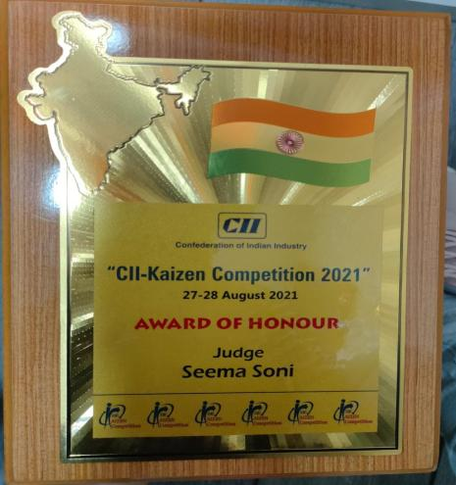
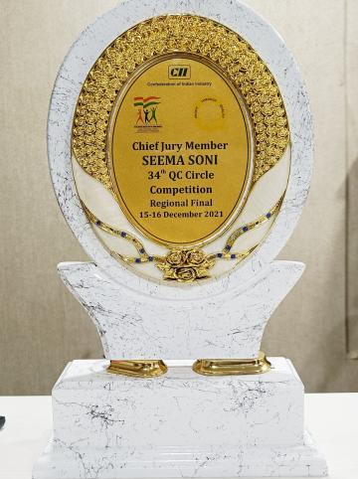
CII-Kaizen Competition Aug-2021
CII-Regional final Dec-2021

Slide 16
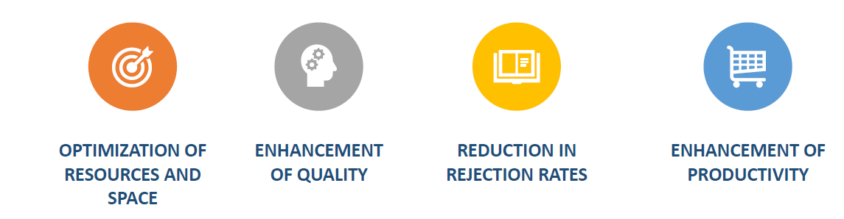

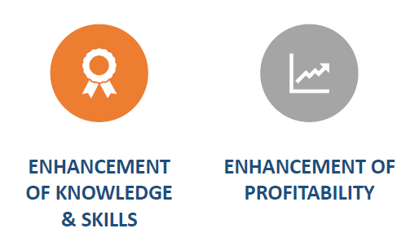
2. Project Objective: To make Company more competitive through Implementation of Lean Tools and Techniques.
Cost reduction
Cycle time reduction
“Waste” minimization
Elimination of non-value-added activities
Resulting in a more “lean,” competitive, agile, and market-responsive company

Slide 17

Our Services for Total Manufacturing System Excellence (Expertise areas as follows):
Execute
Profit
Training
Strategies to increase Profit
Plan

Slide 18
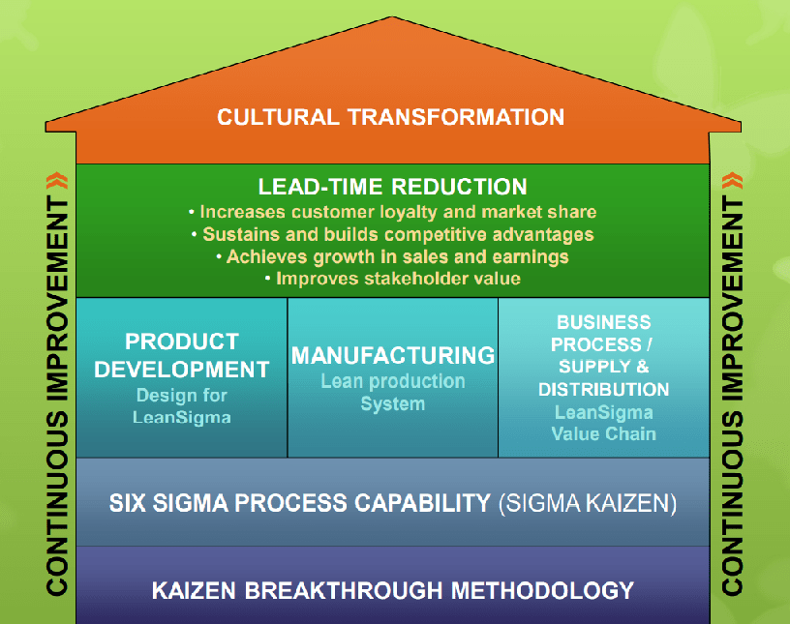

Slide 19
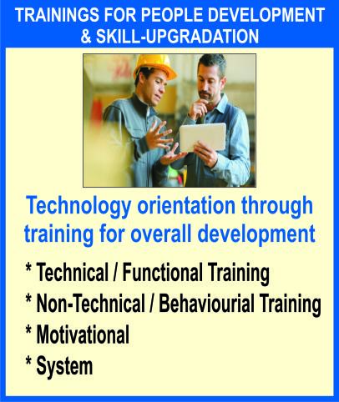

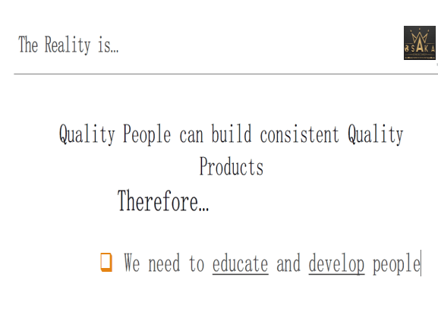
PEOPLE DEVELOPMENT & SKILL-UPGRADATION TRAININGS

Slide 20
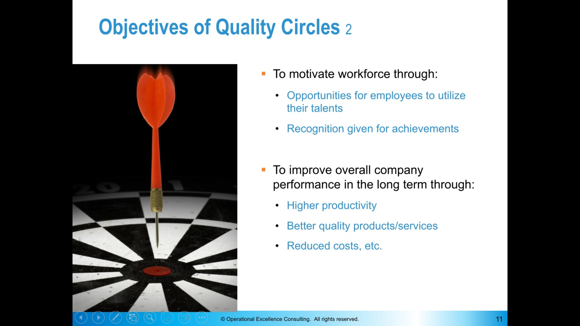
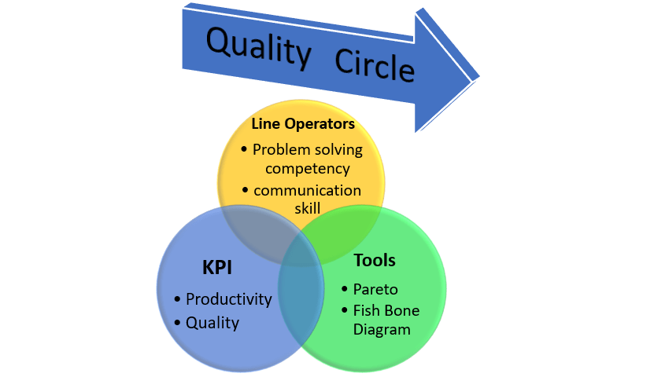
QUALITY CIRCLE

Slide 21
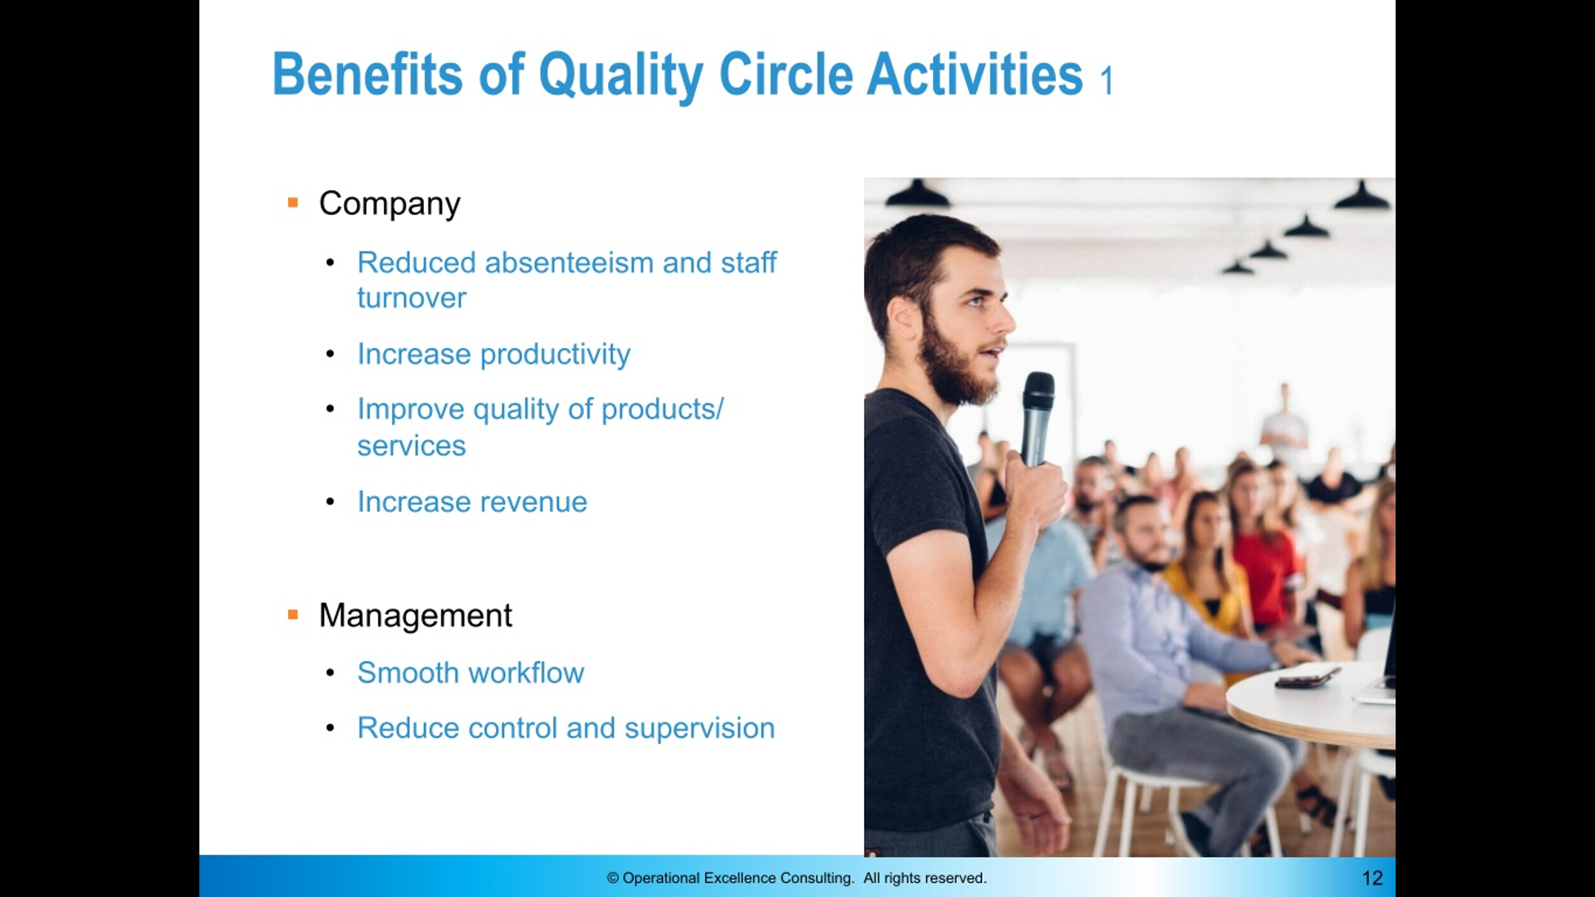

Slide 22
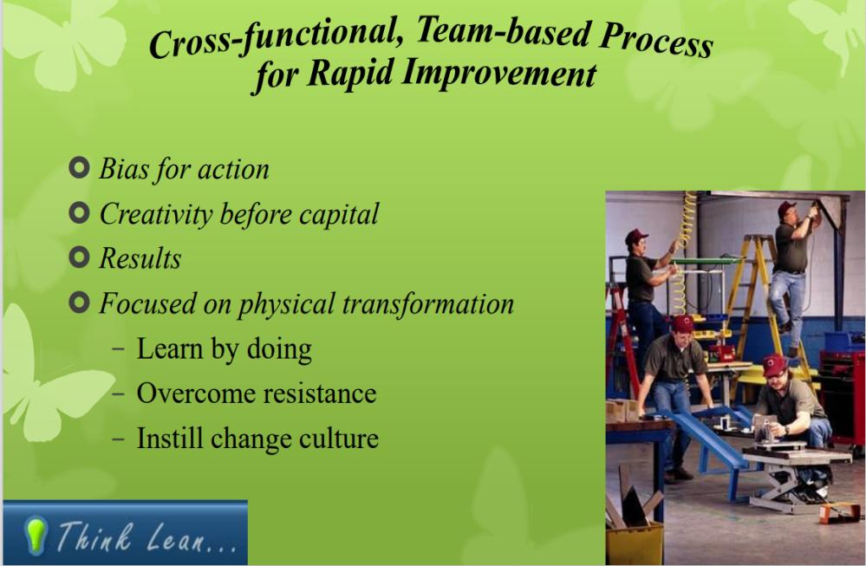
What is Kaizen B r e a k t h r o u g h ?

Slide 23
Training Outline for For Operators Supervisors / Engr / Managers
Lean Manufacturing
5S & Visual Controls
Kaizen
Value Streams
Pull Manufacturing
Mistake Proofing
Quick Changeover
Six Sigma
Lean Accounting
Theory of Constraints
Human Factors
Monozukuri (making things) Hitozukuri (making people) and kotozukuri (making things happen)
P.D.C.A. Principle
5T Principles-Visual Management
Kaizen workshops
Dojo System
Ergonomics Engineering (Human Factors Engineering)
Total Quality Management
Creativity in Problem Solving & methodologies
Communication Skill & Behavioral Quality Art
Leadership Skill and Team building
Personality devlopment
Quality Circle
Quality Management
Production Management
Operations Management
Maintenance Management
Material Handling
Lean, TPM & TQM
Low-Cost Automation
Pick & place mechanisms for productivity & quality
Poka Yoke Management – Quality Management
Material Handling efficiency

Slide 24
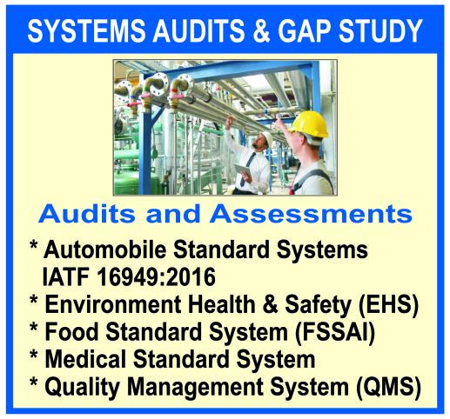
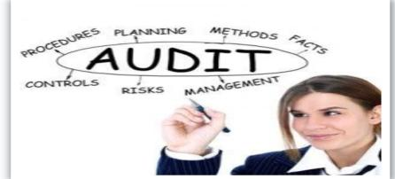
2. Certification Support through actual system application
2.
To Achieve PQCDSME SHOP TARGETS
Automobile Standard Systems IATF 16949:2016
Environment health
Food Standard System
Medical Standard System
Quality Management System (QMS) Guidelines

Slide 25
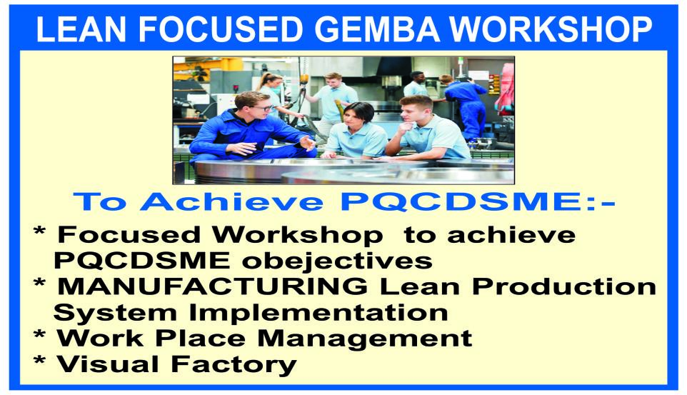
3.

Slide 26
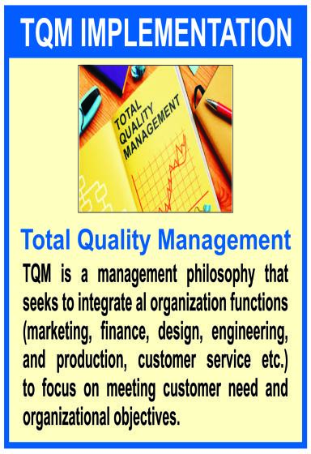
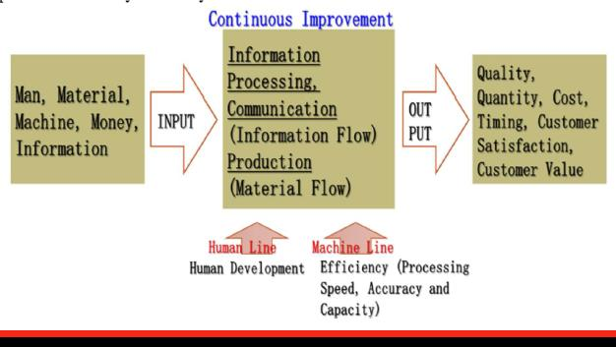
4
TQM PURPOSE

Slide 27
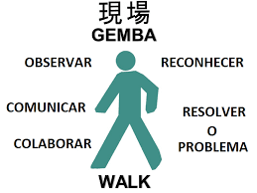
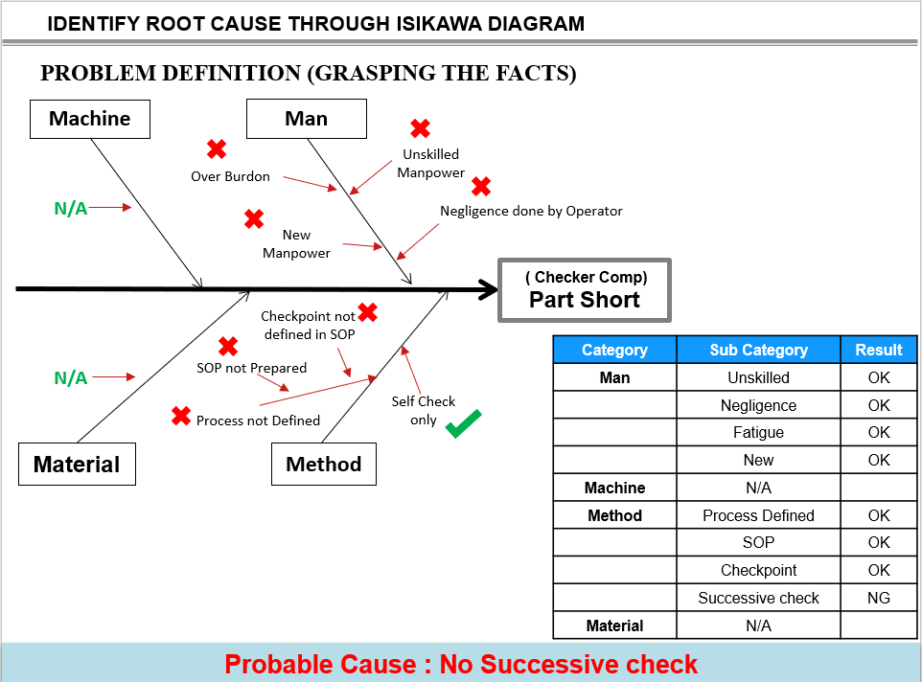

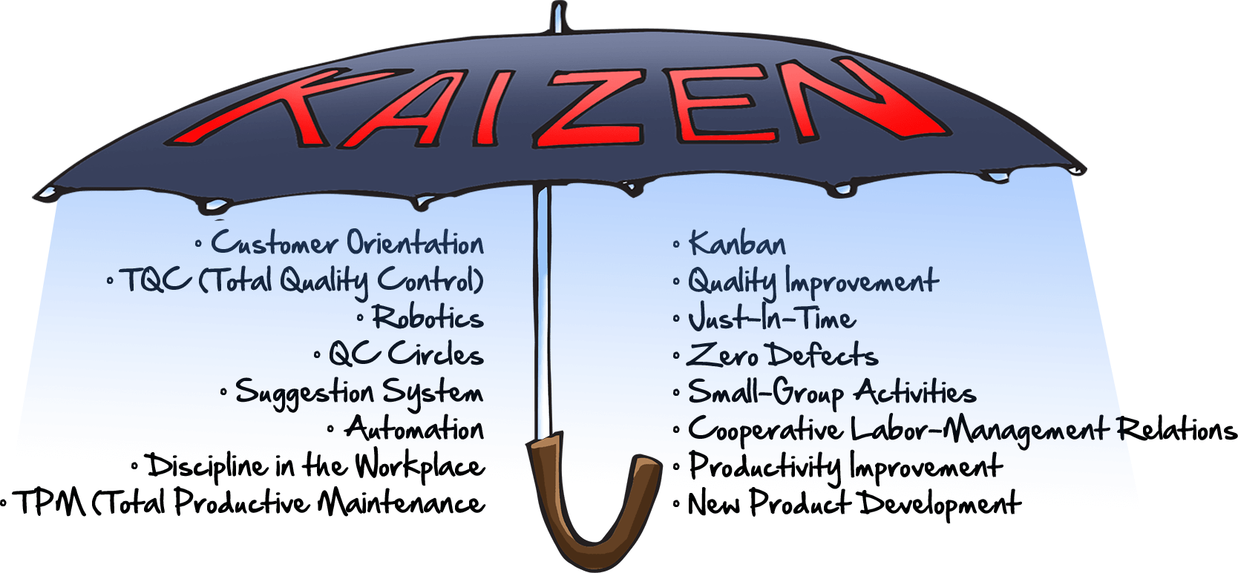
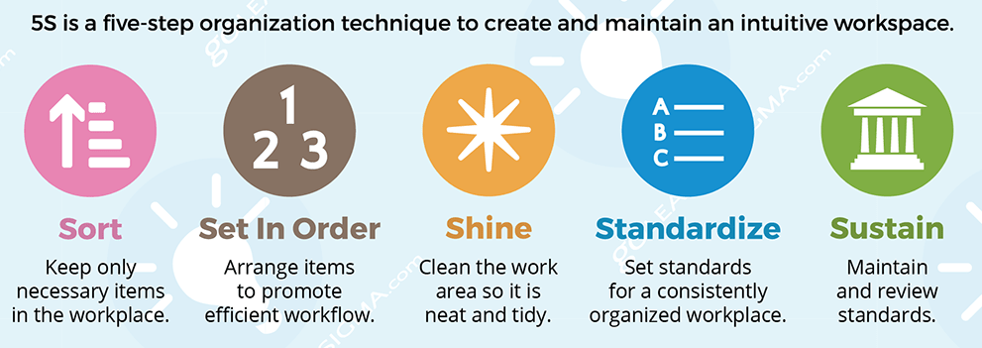
5M + 1E +Q + S + 5S+5T FOCUSED WORKSHOPS

Slide 28
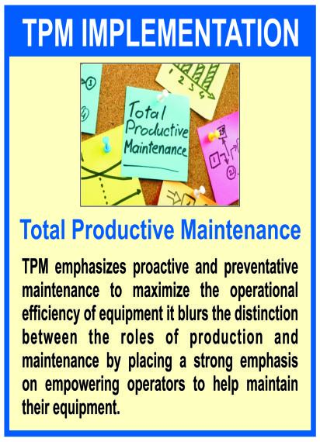
What is TPM:
5.
A method for continuously improving the effectiveness of production equipment and processes
The key difference between TPM and other maintenance programs is that TPM requires the involvement of all people in the organization
TPM aims to achieve a 100% on-demand equipment availability by eliminating:
🠶 Equipment breakdowns and other unplanned downtime
🠶 Scrap and rework by poor equipment performance
🠶 Reduced productivity due to running at reduced speeds, idling, or stoppages requiring operator attention
🠶 Equipment startup losses

Slide 29
CULTURE TRANSFORORMATION-OPPORTUNITIES FOR IMPLEMENTATION & PLANT IMPROVEMENTS
To increase productivity%, Line balancing Study, O.E.E.% Study & Karakuri kaizens activities
Total Predictive Maintenance TPM.
Total Quality Management workplace culture
Activity based Trainings with the objective-People development & Skill upgradation
To enhance operators On job knowledge & increase skill competency level, Regular Operator’s training education through inhouse Gurukul Dojo System.
Safety Controls
Quality circles-Inhouse Competition to enhance teamwork & external participation
Cost optimization in terms of material and manpower.
Optimization of existing resources and space
Material Handling and Storage / Transit flow control
Regular Audits and Re-assessments to validate system and process going on.
Gemba workshops with target team
Motion/SPC/MSA Study
Packing material wastes study & reduction

Slide 30
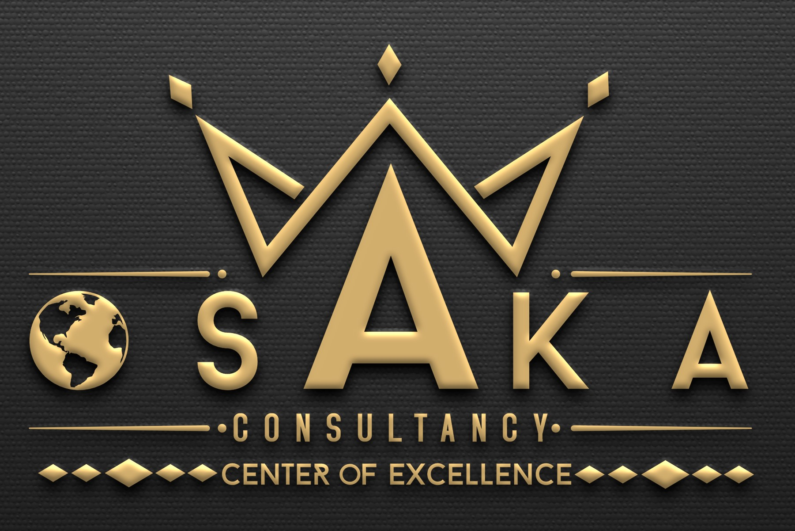
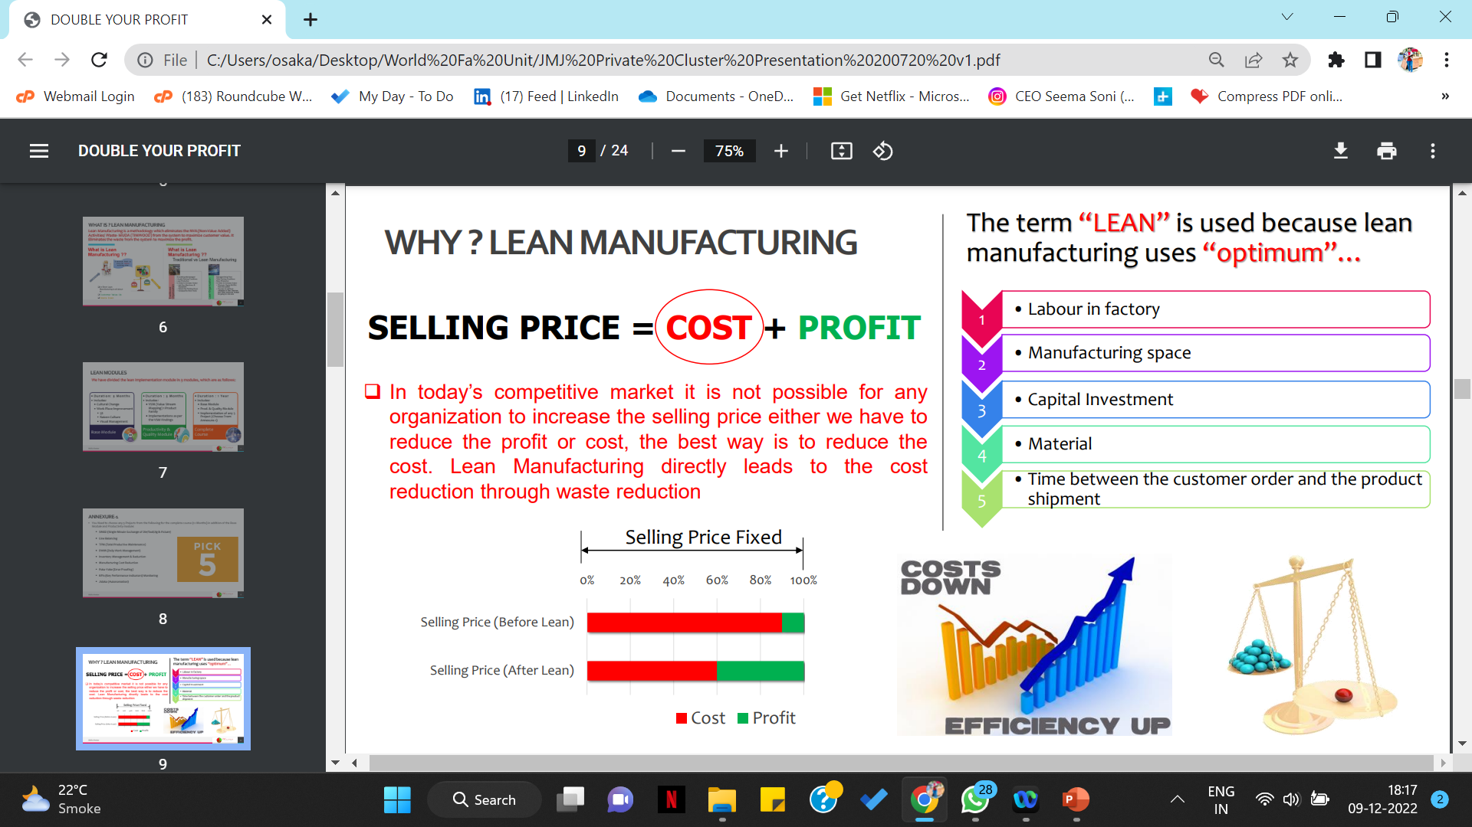
Proposed Tangible Benefits-Our commitments
To shop floor people
Increased job satisfaction
Feeling of contribution to improvement
Less fatigue and improved safety
Progressive and competitive environment
Reduce Injuries –> promotes safety
Reduce Set-up time
Reduce Defects
Reduce breakdowns with better equipment availability
To the Company
Cutting hidden production cost
Increased customer satisfaction
Reduce delays
brings reliable deliveries
Low Inhouse PPM
Zero complaints bring greater confidence & trust
Good Productivity
Wastages reduction
Profit value increased aapx 20 -30% through cost of poor quality reductions

Slide 31
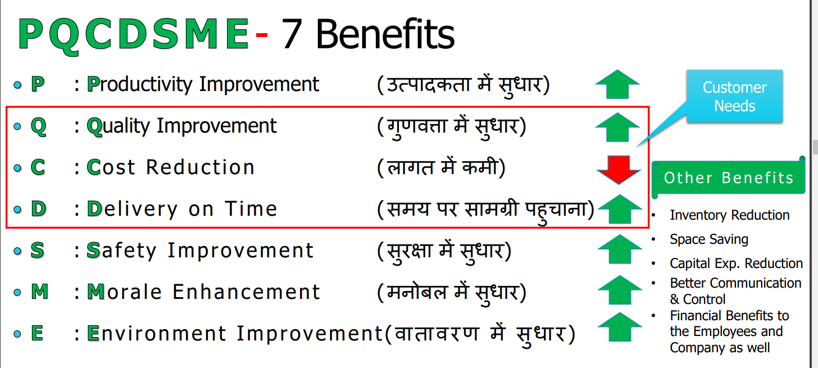
BENEFITS OF TOTAL QUALITY MANAGEMENT

Slide 32

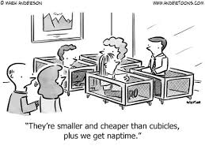
Intangible Benefits
5. Probable Intangible Benefits-Our commitments
I
N
C
R
E
A
S
E
D
COMMUNICATION SKILL
MOTIVATION
TEAM SPIRIT
CUSTOMER SATISFACTION
INTER-PERSONAL RELATIONSHIP
TEAM MORALE
Notes:
ईंटेंजीबेल बेनीफिट कि बात करें तो हमने एरिया सेव किया, एम्प्लोई का मोटिवेशन , टीम भावना , आपस मे व्यवहार एवं कम्युनिकेशन स्किल का विकास हुआ।

Slide 33
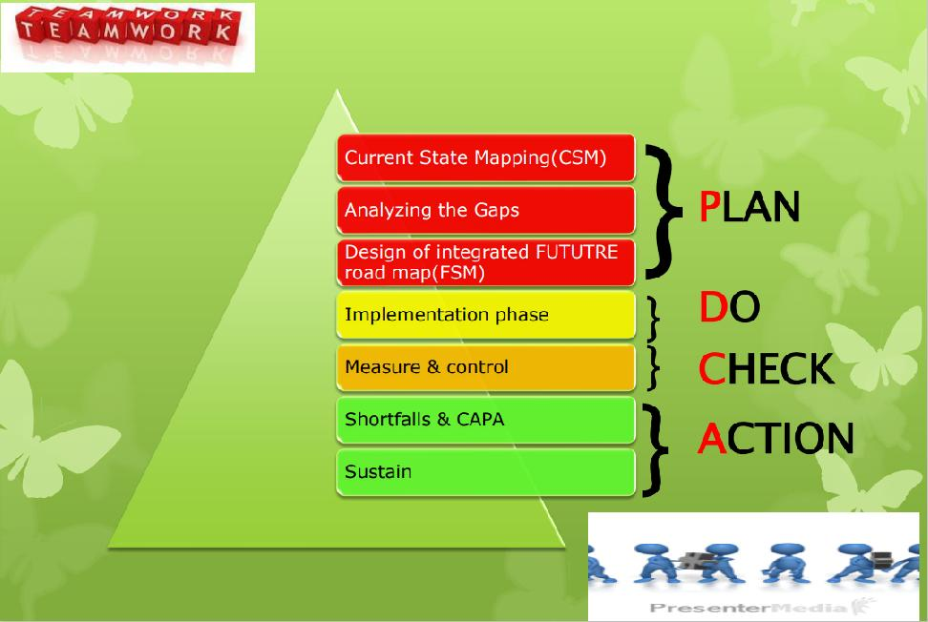
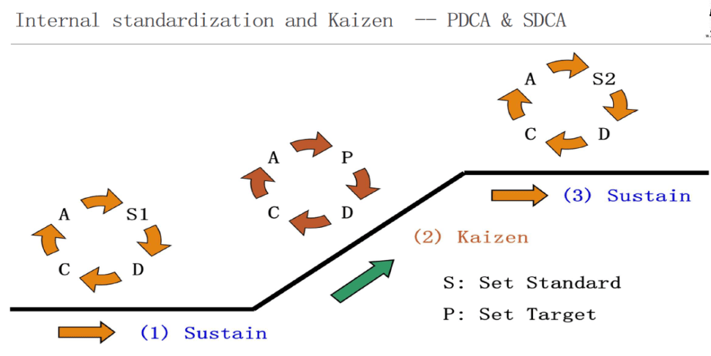
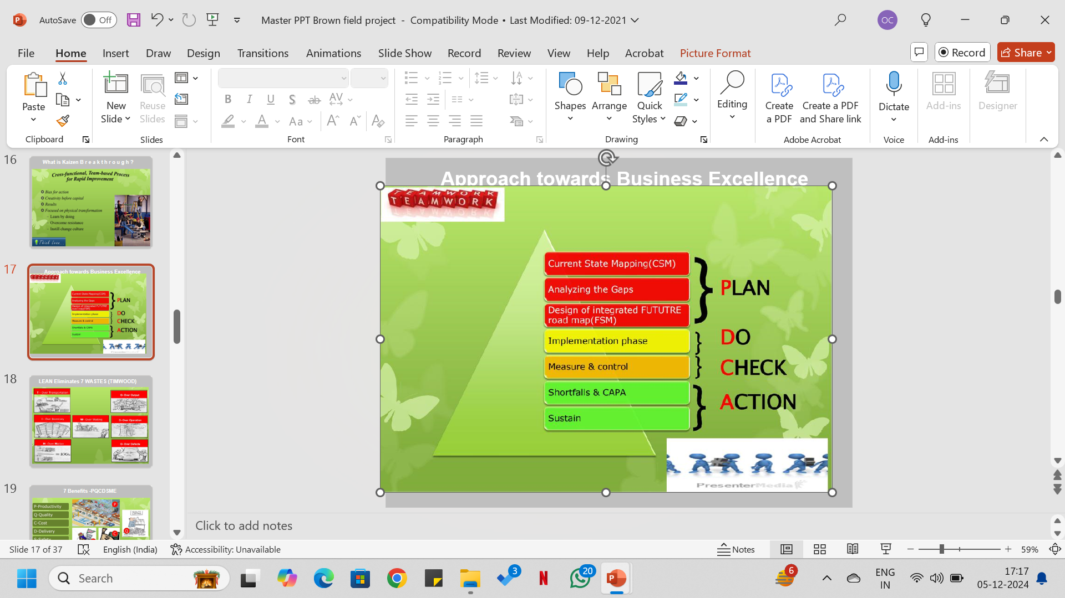
How Project will run :

Slide 34

Communication Mechanism during Implementation:
Weekly DWM meeting
Weekly Gemba CFT
Weekly Report to Email
Monthly Progress report to share with hurdles
Monthly Working man days Calendra Plan to be share
Video Shoots in group of Gemba implementation activities
Self-Monthly audit plan & Audits
Advance Monthly meeting for the Monthly task target sheet in
the form of Calendra wise action
Monthly Review meeting
Monthly Training Plan to be share in advance & deliverables.

Slide 36


Slide 37


Slide 38
For more details, Visit our website- www.osakaconsultancy.com

